Slide 1

MACHINE LEARING FOR WEB VULNERABILITY DETECTION
PROJECT GUIDE:
Ms. V Aparna Varalakshmi (Associate Professor)
PRESENTED BY :
Appidi Giridhar Reddy – 20841A0546
Pathapati Bhanuteja – 20841A0532
S. Sai Sreekar – 20841A0560

Slide 2
INDEX
1. Abstract
2. Introduction
3. Existing system
Disadvantages
4. Proposed system
Advantages
5. Software & Hardware Requirements
6. Literature Review
7. Problem Identification

Slide 3
1. ABSTRACT
Web applications have become an integral part of modern digital interactions, yet they remain susceptible to a wide range of security vulnerabilities that can compromise user data and system integrity. This project presents an innovative approach to enhancing web application security through the application of machine learning techniques for web vulnerability detection. By leveraging a diverse dataset of simulated attack scenarios and legitimate interactions, a robust and adaptive model is developed to identify and classify vulnerabilities such as SQL injection, cross-site scripting (XSS), and cross-site request forgery (CSRF). Feature engineering, selection, and extraction methods are employed to effectively capture intricate patterns indicative of vulnerabilities. Through comprehensive experimentation and performance evaluation, the proposed system demonstrates significant accuracy and efficiency in real-time detection, surpassing traditional rule-based methods. The integration of machine learning into web security not only reinforces the protection of user data and privacy but also contributes to the evolution of proactive defence mechanisms against emerging threats in the dynamic landscape of cyberattacks.

Slide 4
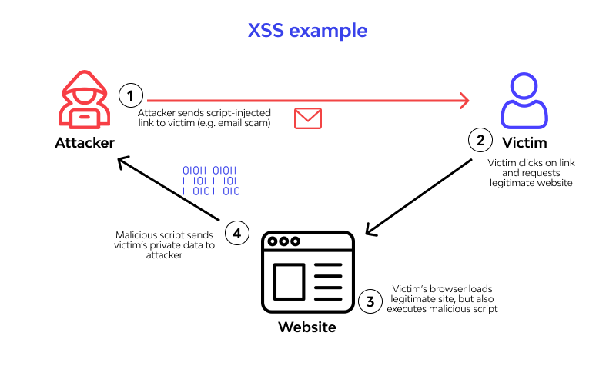
Cross-site Scripting

Slide 5
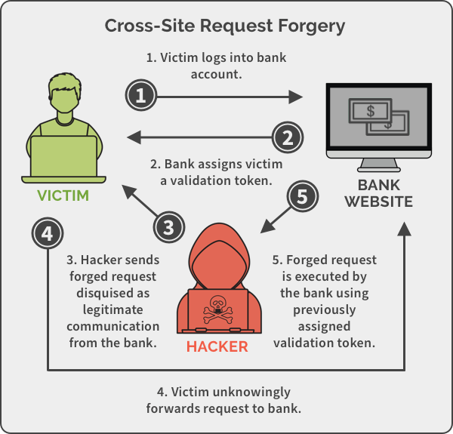
Cross-site Request Forgery

Slide 6

SQL Injection

Slide 7
2. INTRODUCTION
This sophisticated model has been refined through meticulous feature engineering, selection, and extraction methods, enabling it to capture intricate patterns indicative of vulnerabilities.
In an interconnected world dominated by web applications, the imperative to fortify these systems against security breaches has never been more urgent. This project is on a mission to achieve just that, leveraging the formidable capabilities of machine learning for vulnerability detection. By combining a diverse dataset encompassing normal usage and simulated attacks, we have engineered a sophisticated model that autonomously identifies and classifies web vulnerabilities, including SQL injection, cross-site scripting (XSS), and cross-site request forgery (CSRF).
This system, refined through painstaking feature engineering and extensive testing, offers real-time protection against evolving cyber threats, surpassing conventional rule-based methodologies. By embracing machine learning, this endeavor represents a significant step towards a proactive and adaptable defense strategy, fortifying the resilience of web applications and ensuring the security of user data in the face of an ever-changing digital landscape.

Slide 8
3. Existing System
Current web vulnerability detection methods include rule-based approaches, signature-based detection, manual analysis, and web application firewalls (WAFs). Rule-based methods use predefined rules to spot known attack patterns, while signature-based detection relies on predetermined signatures to recognize established threats. Manual analysis and penetration testing rely on human expertise to examine code and behavior, but can be time-consuming and may miss emerging vulnerabilities.
WAFs provide an added layer of protection but can be bypassed by skilled attackers. Anomaly detection aims to find deviations from normal behavior, but distinguishing between legitimate and malicious activities is challenging. These methods face limitations in adapting to evolving web vulnerabilities.
The proposed project aims to address these limitations by employing machine learning techniques, which offer adaptability, scalability, and the ability to identify novel and subtle attack patterns, enhancing the effectiveness and efficiency of web vulnerability detection.

Slide 9
Disadvantages :
Limited Adaptability: Rule-based and signature-based methods rely on predefined rules and patterns, making them less effective at identifying new and evolving attack techniques. As attackers develop novel strategies, the existing system struggles to keep up, resulting in a higher likelihood of false negatives.
False Positives and Negatives: Rule-based and signature-based systems can generate false positives (incorrectly flagging legitimate requests) and false negatives (failing to detect actual attacks), leading to inefficiencies in the detection process and increased operational overhead.

Slide 10
4. Proposed System
The proposed system for web vulnerability detection leverages machine learning to revolutionize traditional methods by creating an adaptive and intelligent defence mechanism. By analysing a diverse dataset encompassing legitimate and malicious interactions, the system employs supervised and unsupervised learning to autonomously identify a wide range of web vulnerabilities.
Through feature engineering and real-time monitoring, it effectively differentiates between normal and malicious activities, minimizing false positives and negatives. This dynamic approach not only enhances accuracy but also enables the system to continuously learn and evolve in response to emerging cyber threats, offering a proactive and robust solution for web application security.

Slide 11
Advantages :
1. High Accuracy: Provides the most accurate type of vulnerability that is found.
2. High Efficiency: The system is more efficient in handling the attacks/threats than the previous one.
3. Adaptability to Emerging Threats: Unlike traditional rule-based methods, the machine learning model can adapt to new types of attacks that may not have been seen before. This provides a proactive defense against evolving cyber threats.
4. Reduced False Positives: The system is designed to minimize the occurrence of false alarms, ensuring that genuine user interactions are not mistakenly flagged as potential threats. This improves the overall user experience and reduces unnecessary alerts for administrators.
5. Real-Time Detection: The system operates in real-time, swiftly identifying and responding to potential vulnerabilities as they occur. This immediate response time is crucial in preventing successful cyberattacks and minimizing potential damage.

Slide 12
5. Hardware Requirements
Hardware Specifications
Processor : Intel(R) Core i5 2.4 Ghz
Ram : 16 GB
Hard Disk : 512 SSD – 1 TB

Slide 13
Software Requirements
Software Specifications
Programming Language : Python
Libraries : Pandas, Numpy, Matplotlib, Sci-kit learn
Operating System : Windows
IDE : VS Code, Jupyter Notebook

Slide 14
6. Literature Review Sample

Slide 15
Paper 1 - Machine Learning for Web Vulnerability Detection: The Case of Cross-Site Request Forgery
Authors : Stefano Calzavara, Mauro Conti, Riccardo Focardi, Alvise Rabitti, and Gabriele Tolomei. (2020)
Description : In this article, we propose a methodology to leverage Machine Learning (ML) for the detection of web application vulnerabilities. Web applications are particularly challenging to analyse, due to their diversity and the widespread adoption of custom programming practices. ML is thus very helpful for web application security: it can take advantage of manually labeled data to bring the human understanding of the web application semantics into automated analysis tools. We use our methodology in the design of Mitch, the first ML solution for the black-box detection of Cross-Site Request Forgery (CSRF) vulnerabilities. Mitch allowed us to identify 35 new CSRFs on 20 major websites and 3 new CSRFs on production software.

Slide 16
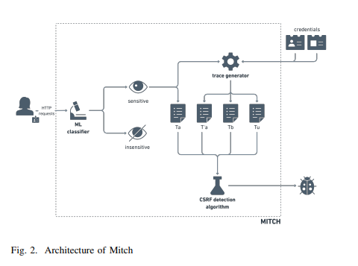
Design

Slide 17
Limitations :
1. Specificity to CSRF: The study's focus on Cross-Site Request Forgery (CSRF) may limit its applicability to other types of web vulnerabilities, potentially reducing its overall generalizability.
2. Dependency on Labeled Data: The methodology relies on the availability of manually labeled data for training the machine learning model, which may be challenging to obtain, especially for less-studied vulnerabilities.
3. Model Interpretability: Complex machine learning models, particularly deep learning ones, may lack interpretability, potentially hindering the ability to understand and address false positives/negatives.
4. Dynamic Threat Landscape: The model may struggle to adapt to emerging threats, as web vulnerabilities and attack techniques are constantly evolving. Continuous re-training and updating of the model are crucial.
5. Resource Intensive Training: Depending on the complexity of the ML model, significant computational resources may be required for training, potentially posing a challenge for organizations with limited computational capabilities.
Problem Outcome :
1. Risk of Overfitting: The model may excel on training data but struggle to generalize to new data, potentially leading to inaccurate vulnerability detection in practical scenarios.
2. Challenge in Adapting to Emerging Threats: The model might face difficulties in adapting to new and evolving web vulnerabilities, as it relies on historical data for training.
3. Resource Intensive Deployment: Implementing the model in real-time web applications may require significant computational resources, potentially limiting its scalability in resource-constrained environments.

Slide 18
Paper 2 - A Machine Learning Approach for Web Application Vulnerability Detection Using Random Forest
Authors : Chandan Singh , V. Vijayalakshmi , Harsh Raj (2022)
Description : Website attacks have been one of the main threats to websites and web portals of private and public organizations. In today's digital world web applications are an important part of day-to-day life so it has become a challenging task to secure the applications. The attackers aim to extract sensitive information about the users through the URL links sent to the victims. We are trying filling the gap of traditional methods to stop the attacks, but the traditional methods fail to perform well as the attackers are becoming good at attacking the web applications. People are presently searching for reliable and consistent web application attack detection software. This model aims to secure web applications of vulnerabilities and from different types of attacks using a machine learning approach which has more accuracy compared to other machine learning algorithms since we are using Random Forest Model.

Slide 19
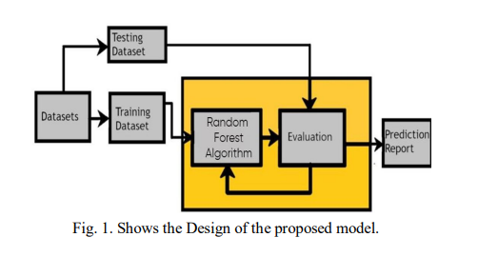
Design

Slide 20
Limitations :
1. Dependence on Historical Data: The Random Forest Model's effectiveness heavily relies on the quality and representativeness of the historical data used for training. If the dataset is not comprehensive or lacks diversity, the model may struggle to adapt to new attack patterns and may not effectively detect emerging threats.
2. Resource Intensiveness: Implementing a Random Forest Model in real-time environments with high traffic can demand substantial computational resources. This might pose scalability challenges, especially for organizations with limited computing capabilities, potentially making it less suitable for resource-constrained environments.
3. Maintenance and Updates: Cyber threats are constantly evolving. The model will require continuous monitoring, updating, and retraining to stay effective. This demands ongoing resources and expertise to ensure its relevance and accuracy over time.
4. Potential for False Positives/Negatives: The model may generate false alarms (false positives) or miss actual vulnerabilities (false negatives). Striking the right balance between high precision and recall is crucial, as overly sensitive models may produce more false positives.
Problem Outcome :
1. Limited Adaptability to Evolving Attack Techniques:
- Problem Outcome: The model may struggle to keep pace with rapidly evolving attack methods. Attackers constantly refine their techniques, potentially outpacing the model's ability to detect new and sophisticated attacks.
2. False Positives Impact User Experience:
- Problem Outcome: Overly sensitive detection may lead to a higher rate of false positives. This could result in legitimate user activities being flagged as potential threats, causing frustration and hindering the user experience.
3. Resource Intensive Implementation:
- Problem Outcome: Implementing the Random Forest Model in real-time, high-traffic web application environments may require substantial computational resources. This could pose scalability challenges, particularly for organizations with limited computing capabilities.

Slide 21
Paper 3 - Web vulnerability mining based on machine learning
Authors : Zhengshuang Shi
Description : Web is an area of continuous development and innovation every year. It not only changes the way people deal with personal, social contact and business, but also ushers in new opportunities in the era of Internet. Network security develops rapidly. Web security also needs new methods to solve. Machine learning technology is used to detect attacks, and its algorithm model is used to predict attacks. This kind of method that can automatically update the module to adapt to the new attack can greatly reduce the manpower consumption. This paper sorts out the methods of mining typical web attack vulnerabilities using machine learning. The future development trend is given.

Slide 22

Data is the key-source here.

Slide 23
Limitations :
1. Dependency on Quality Data: The effectiveness of machine learning models heavily relies on the quality, diversity, and quantity of the data used for training. Insufficient or biased data may lead to inaccurate predictions and vulnerability detection.
2. Challenges in Generalizing to Novel Threats: Machine learning models may struggle to detect entirely new and innovative attack techniques that have not been previously encountered. The model's performance on emerging threats may be limited.
3. Resource Intensiveness: Implementing and maintaining machine learning models, especially those that require significant computational resources, can be resource-intensive. This may pose challenges for organizations with limited computing capabilities.
Problem Outcome :
1. Inaccurate Predictions on Novel Attacks:
- Problem Outcome: The model may struggle to accurately detect completely new and innovative attack techniques that have not been encountered before. This can lead to vulnerabilities going undetected.
2. False Positives Impact User Experience:
- Problem Outcome: Overly sensitive detection may lead to a higher rate of false positives. Legitimate user activities may be flagged as potential threats, causing frustration and hindering the user experience.
3. Resource Intensive Implementation:
- Problem Outcome: Implementing and maintaining machine learning models, especially those that require significant computational resources, can be resource-intensive. This could pose scalability challenges, particularly for organizations with limited computing capabilities.

Slide 24
6. PROBLEM IDENTIFICATION
In the realm of web security, the ever-evolving landscape of cyber threats poses a significant challenge. Traditional methods of web vulnerability detection, which often rely on rule-based systems or signature-based techniques, struggle to keep pace with the sophistication and diversity of modern attack vectors. These methods can be rigid, lacking the adaptability needed to effectively identify emerging vulnerabilities and novel attack patterns.
Furthermore, the dynamic nature of web applications, characterized by a wide array of technologies, frameworks, and custom programming practices, adds complexity to the security landscape. This diversity makes it difficult to establish universal rules or patterns for vulnerability detection, leading to potential blind spots in the security posture of web applications.
Moreover, the prevalence of interconnected systems in today's digital ecosystem amplifies the potential impact of a successful attack. Web applications serve as gateways to sensitive user data, and any compromise in their security could have far-reaching consequences for individuals and organizations alike.
The need for a more robust and adaptable approach to web vulnerability detection is evident. Machine learning presents a promising avenue, as it can leverage extensive datasets to identify intricate patterns indicative of vulnerabilities. However, challenges remain in harnessing this technology effectively, ensuring that the model can accurately discern between legitimate interactions and potential threats while adapting to the evolving tactics of cyber adversaries.
In summary, the identified problem lies in the inadequacy of traditional methods in keeping pace with the dynamic and diverse nature of web vulnerabilities. There is a pressing need for a more sophisticated and adaptive approach, such as machine learning, to fortify web application security in the face of an ever-evolving threat landscape.

Slide 25
THANK YOU !
Feel free to ask any doubts.

